Slide 1
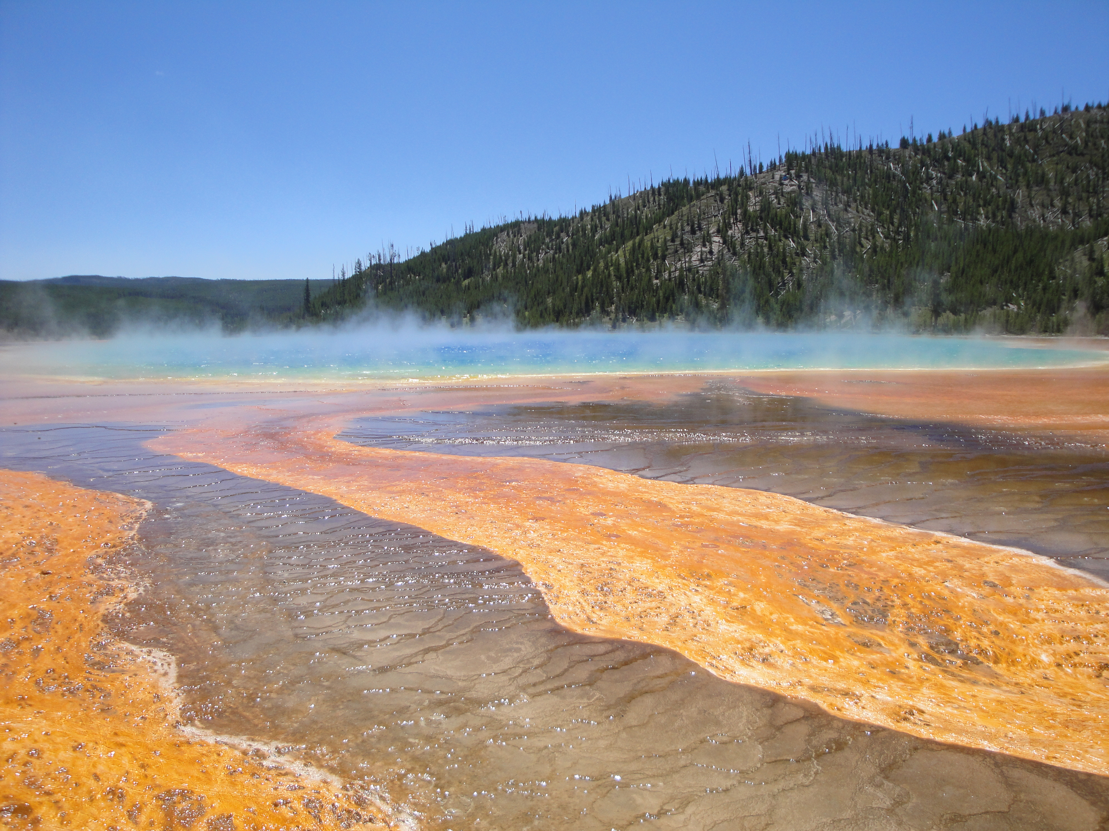
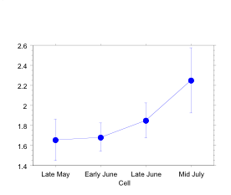
Title of my project written as a sentence and not in all capital letters
My name
My program/department
Research Advisor = Dr. Awesome Mentor
Introduction
Scholarship on X and Y suggest that A and B play an important role…
This box is simply a text box with purple 10 pt lines framing the box. The header in this example is size 44 and the general text is size 32.
Use a font size of 24-32 pts for the general text of your poster. Your poster will be easier to read if the general text is written with a serif font, such as Palatino, Times New Roman (shown here), or Cambria.
Put the header for each section in size 32-48 pt. The headers are easier to read if written in non-serif fonts such as Helvetica, Arial (shown above), Calibri, or Geneva.
Results
We found that ….
This section can be written as a bulleted list or with complete sentences that describe your results/scholarly findings. You can include graphs, figures, photographs in separate boxes as part of your results. Take a look at scholarly posters hanging in your department/program for ideas on how to write and show your scholarly findings. The results might take up more than one column on your poster.
Again this box is simply a text box with purple 10 pt lines framing the box. The header in this example is size 44 and the general text is size 32.
Use a font size of 24-32 pts for the general text of your poster. Your poster will be easier to read if the general text is written with a serif font, such as Palatino, Times New Roman (shown here), or Cambria.
Results
We also found that ….
Discussion
These results support the idea that …
This section may be written as a list (with bullets) or in complete sentences (as narrative). This section might be titled discussion or conclusions. Check with your research mentor on ideas to include in this section and look at other scholarly posters for ideas on how to format this section and on what information to include.
Next Steps
If your project is not complete and you intend to continue your scholarship into the fall semester or for a senior project, you might include a short section that describes your plans/next steps/future directions.
Acknowledgements
This project was funded by the __ be sure to get the name correct!_____ Endowment at Denison University, with additional support from _______. Jane Doe and Jim Noname assisted with data collection and I appreciated their help.
Log Std. CPUE
Figure 5: Mean Log Std. CPUE (+ 1SE) for 2004. CPUE is a measure of the number of animals present in the sample.
Scholarly Approach/Methods
I sampled/read/ collected/ measured/ analyzed/programmed, or other methods in order to … If helpful to telling your “story”, this section could refer to an image on the poster or to Figure 1.
This box is simply a text box with purple, 10 pt lines framing the box. The header in this example is size 44 and the general text is size 32.
Use a font size of 24-32 pts for the general text of your poster. Your poster will be easier to read if the general text is written with a serif font, such as Palatino, Times New Roman (shown here), or Cambria.
Put the header for each section in size 32-48 pt. The headers are easier to read if written in non-serif fonts such as Helvetica, Arial (shown above), Calibri, or Generva.
Works Cited
You should include a list of scholarly articles/books and other resources that you cited on your poster (for a Works Cited or Literature Cited section). If you label this section a Bibliography, then your list includes items that you consulted for the project, but did not necessarily cite on your poster.
Check with your research mentor on how to properly format the citations in your academic discipline.
Figure 1. Example of a hot spring we sampled for thermophiclic bacteria. This hot spring was located in Yellowstaone National Park. The colors in the spring are caused by different species of bacteria and algae. Photo by J. Rettig.

